Slide 1
Rheumatic Fever
Dr Vivek c warrier
Senior Resident
Department of Cardiology
Calicut Medical College

Slide 2
Leading cause of acquired heart disease in children and young adults worldwide
Systemic inflammatory disease initiated by pharyngeal infection with group A beta Hemolytic streptococci
a/c inflammation of heart , joints , skin , subcutaneous tissue,CNS
Now classified as a connective tissue / collagen vascular disease

Slide 3
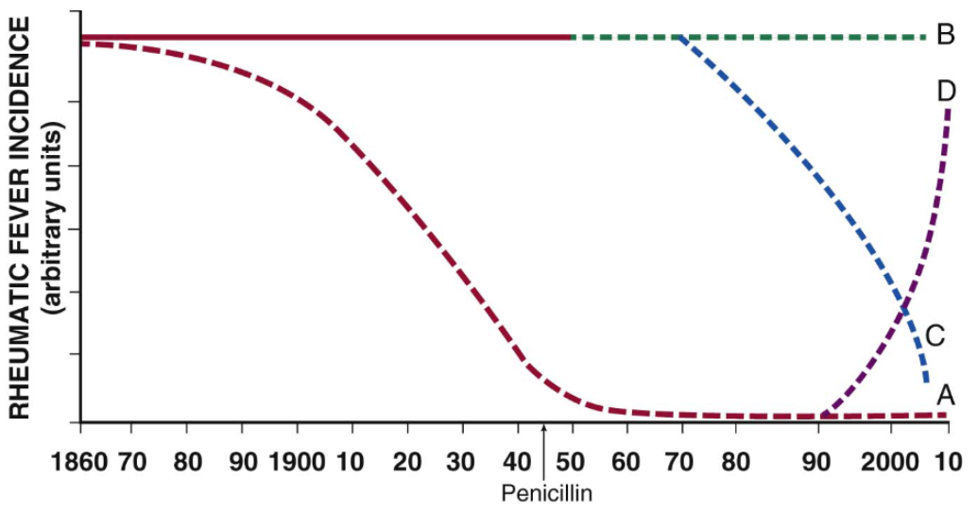
EPIDEMIOLOGY

Slide 4
Four patterns of incidence of rheumatic fever over past 150 years.
Curve A – preantibiotic fall in the incidence of RF, typical of industrialised countries.
Curve B – persistent high incidence in regions with no comprehensive programme for prevention – Africa, middle east, eastern europe, south america, indeginous communities of australia
Curve C – post antibiotic fall – countries with programmes for primary and secondary prevention – cuba, costa rica, martinique and guadeloupe
Curve D- fall and rise in incidence in countries like the Soviet Republics of central Asia

Slide 5
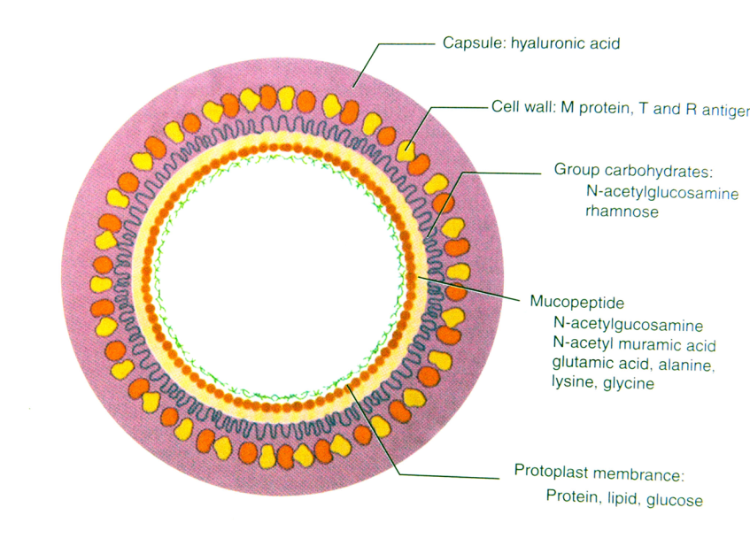
AGENT

Slide 6
Group A Streptococci:Components of Clinical Interest
Capsule: Hyaluronic Acid: Non antigenic, antiphagocytic
Cell Wall:
Surface Protein:
M protein: Type Specific Antigen: Virulence factor
T protein
R protein
Group A carbohydrate: N acetyl glucosamine+ Rhamnose: Group specific antigen
Mucopeptides: common to many bacteriae
N Acetyl glucosamine
N Acetyl muramic acid
Protoplast(Cytoplasmic membrane)

Slide 7
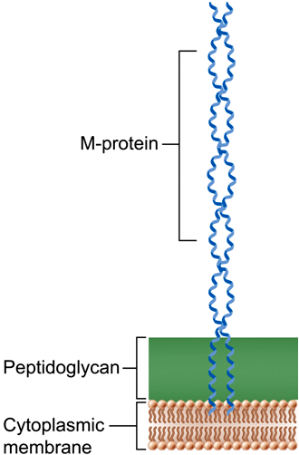
M protein
Major surface antigen
Major Virulence factor
Resistance to phagocytosis – Binds to Serum factor H, Destroying C3 convertase and preventing opsonization by C3b.
Has epitopes causing cross-reactivity with myocardium, synovia, skin & brain.
Notes:
M protein has an NH2 terminal which is hypervariable--- Basis for Lancefields M serotyping.....Therefore opsonogenic antibodies are type-specific depending on hypervariable sequence.... Antiphagocytic properties help evade immune response for 2 weeks...After that type specific antibodies are formed which bind to NH2 region and cause complement fixation and opsonophagocytosis.
7

Slide 8
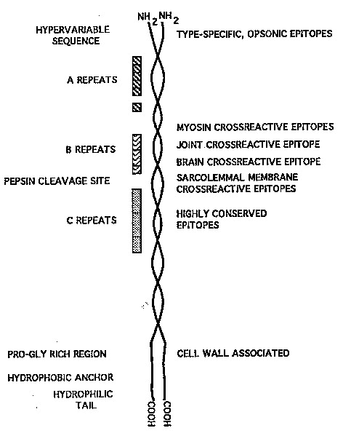
Alpha helical coiled- fibrillar protein– significant homology in structure & amino acid sequences to tropomyosin, myosin, keratin, vimentin & laminin.
It has a hypervariable NH2- terminal and a conserved C-terminal.
The NH2- terminal is responsible for the formation of opsono-phagocytic Abs after around 2 weeks of infection.
The body is divided into A, B and C repeats based on the peptide sequence periodicity.
The B repeat region is the immunodominant region and elicit an exaggerated immune response(B cell)– however this is not opsonic.
Notes:
Epitope/ Antigenic determinant is part of an antigen that is recognised by the immune system—Ab, Bcell or T cell... The recognising portion of the antibody is called paratope.
8

Slide 9
The C repeat region is considered to have conserved T cell epitopes that also elicit tissue specific immune response
( basis for RF-vaccine research)
Based on the conserved C repeat regions Class I & Class II GAS strains are named.
It is the Class I M-type of which belongs the strains 1,3,5,6,14,18,19 and 24 ---that have been associated with RF

Slide 10
Host
Cheadle (1889) reported that chance of having RF in an individual with family history of previous RF is 5 times compared to others.
The lifetime cumulative incidence of RF in populations exposed to rheumatogenic GAS infections is constant at 3 to 6 % regardless of geography or ethnicity.(Braunwald)
In a 2011 metaanalysis that quantitated the genetic susceptibility of RF, the overall estimated heritability was 60%
(Engel et al. Genetic Susceptibility to Acute Rheumatic Fever: A Systematic Review and Meta-Analysis of Twin Studies. Plos-one, 2011.)
Risk of Rheumatic fever is increased 6 times in Monozygotic twins than in Dizygotic twins.

Slide 11
Genetic susceptibility to RF
No conclusive pattern of inheritance could be elucidated.
HLA-II (Chr 6) is the gene most associated with RF and development of RHD
HLA-DR7- mostly associated with progressive valvular lesions in RHD
HLA-DR53, HLA-DQA, HLA-DR4, HLA-DR9
Components of Adaptive Immune Response in addition to HLA
- CTLA 4

Slide 12
Others
Components of Innate Immune Response:
Ficolin 2
Mannose binding Lectin 2
Receptor for Fc Fragments of IgG
Toll Like Receptor 2
Cytokine Genes
TNF α and TGF β, IL 1 receptor A, IL – 10
B cell alloantigens

Slide 13
Environment
Overcrowding
Poverty
Poor nutrition
Poor hygiene
Poor access to health care
Rapid spread
Lack of primary prevention
Lack of secondary prevention

Slide 14
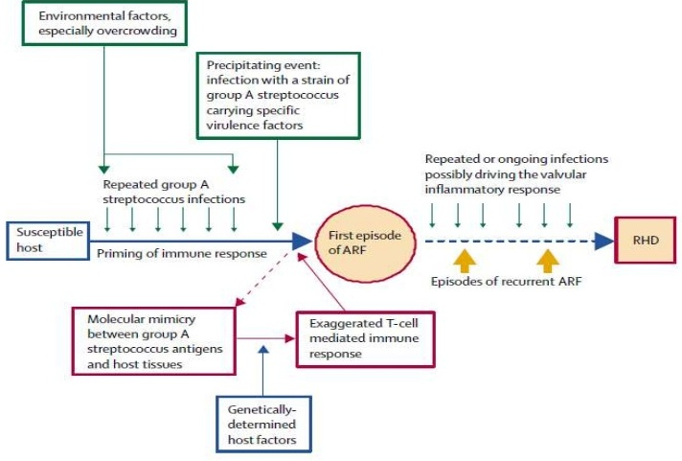

Slide 15
PATHOLOGY
The inflammatory process causes damage to collagen fibrils and connective tissue ground substance (fibrinoid degeneration).
Classified as connective tissue or collagen vascular disease.
There is additional generalized vasculitis-like inflammation throughout the body.

Slide 16
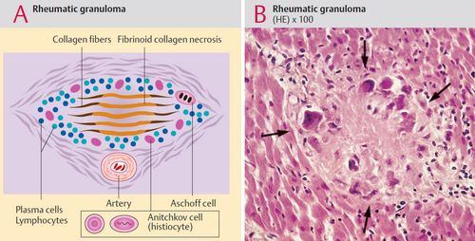
CARDITIS
Inflammation of sub-epicardial, sub-endocardial and perivascular connective tissue.
Characterized by ASCHOFF BODY (Hallmark of Rheumatic Carditis)
They may be found in endocardium, myocardium & pericardium

Slide 17
Lack of myocardial damage
Numerous clinical, imaging, and pathological studies indicate that rheumatic
fever does not cause myocardial damage.
Myocardial necrosis is rarely observed in endomyocardial biopsy
Levels of circulating biomarkers of myocardial damage, such as troponins and creatine kinase, have been reported to be normal, or only
insignificantly increased.
Echocardiographic study of acute rheumatic fever demonstrated preserved myocardial systolic function, regardless of the severity of valvular involvement and heart failure.

Slide 18
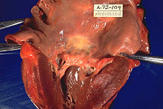
McCallum’s patch
McCallum’s patch: Gross finding of endocardial thickening in the posterior wall of LA due to inflammation as well as ‘jet’-trauma .

Slide 19
Rheumatic Verrucae
-Due to progressive inflammation causing necrotic collagen to project outwards from the valve, On which platelet thrombi deposit.
- Rheumatic verrucae occur on the atrial surface at sites of valve closure
and on the chordae.
-The valves become edematous thickened and vascularised.

Slide 20
PATHOGENESIS
Pharyngeal infection with GAS leads to activation of
cells of the innate immune system.
Neutrophils,macrophages, and dendritic cells phagocytose the Bacteria, and then present antigens to T cells, in turn leading to activation of humoral and cellular immune responses.
The immune response becomes
cross-reactive with human tissues in susceptible
Individuals( MOLECULAR MIMICRY)

Slide 21
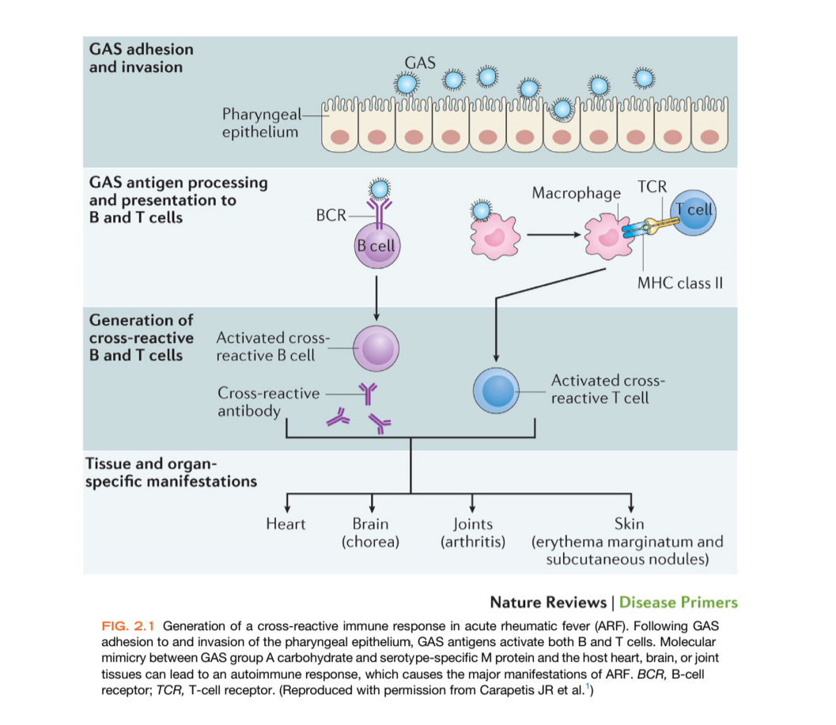

Slide 22
Cross Reactors
Laminin and laminar basement membrane of valves
Cardiac Myosin
Dopamine receptors, Gangliosides, Tubulin in neuronal cells.
Group A carbohydrate -N acetyl Beta D Glucosamine(GlcNAc)
Streptococcal M protein
GlcNAc

Slide 23
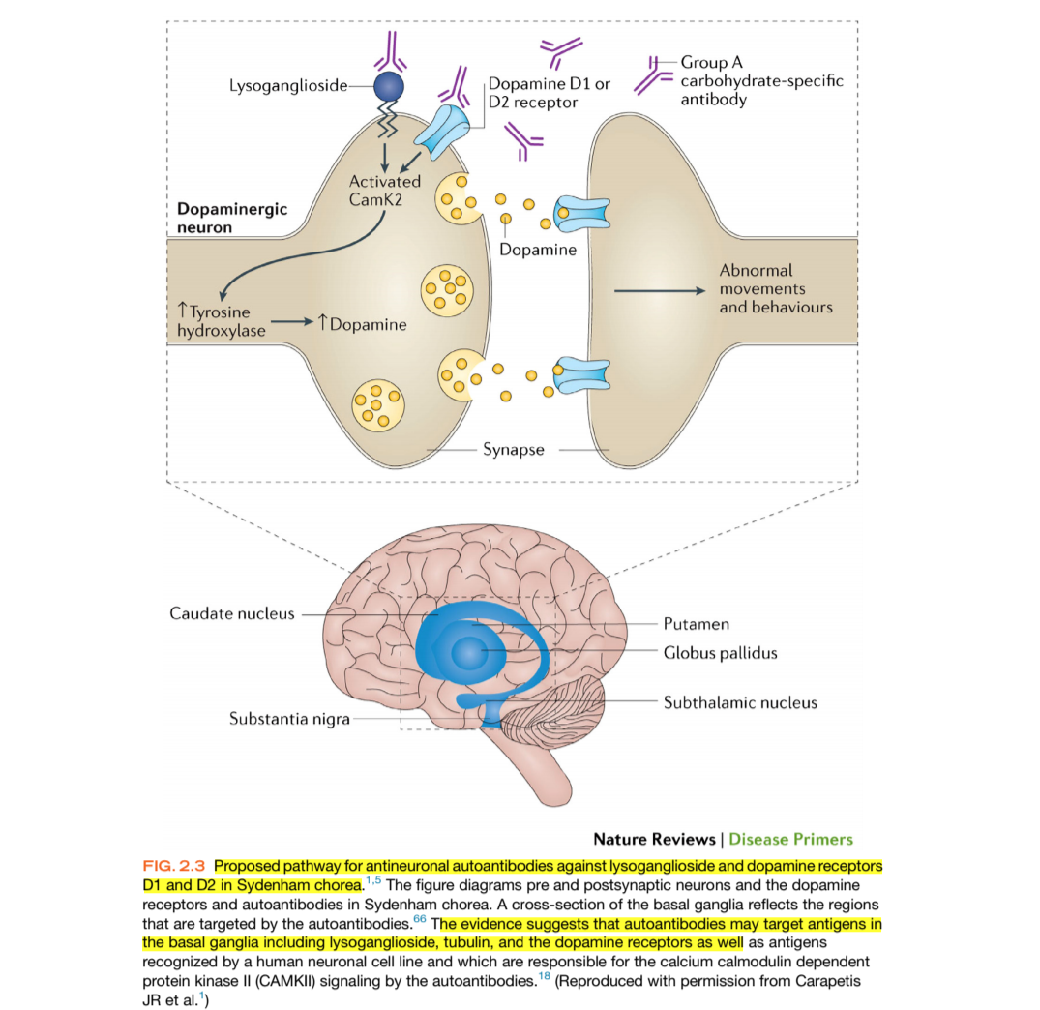

Slide 24
CURRENT PATHOGENESIS…
Pathological findings and immunological studies suggest that the primary site of rheumatic-fever-related damage is the subendothelial collagen matrix.
Upon streptococcal infection, an M protein N­terminus
domain binds to the CB3 region in collagen type IV.
This interaction initiates an Antibody response to the collagen that might lead to systemic targeting of collagen

Slide 25
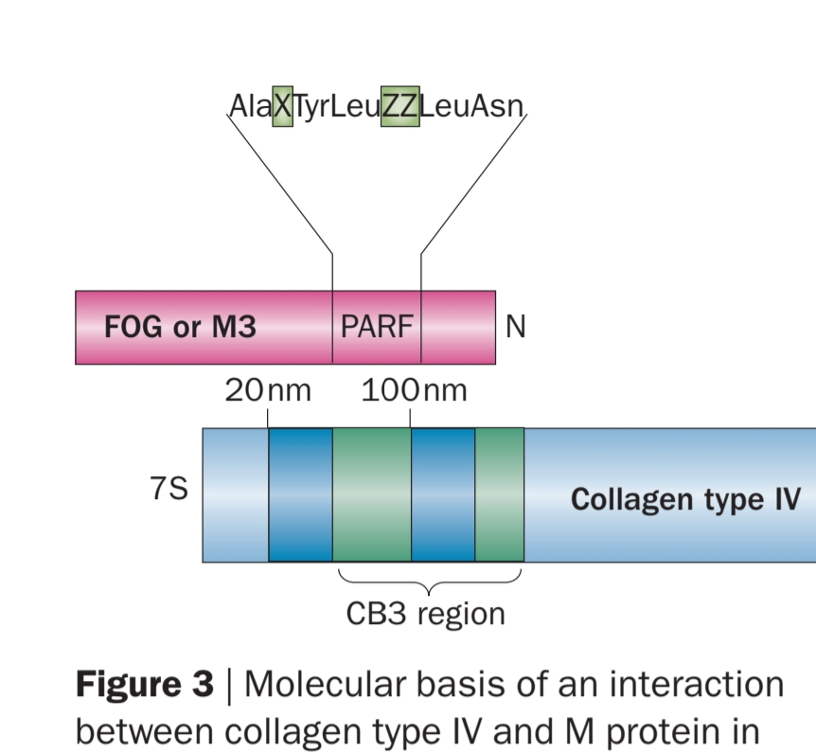

Slide 26
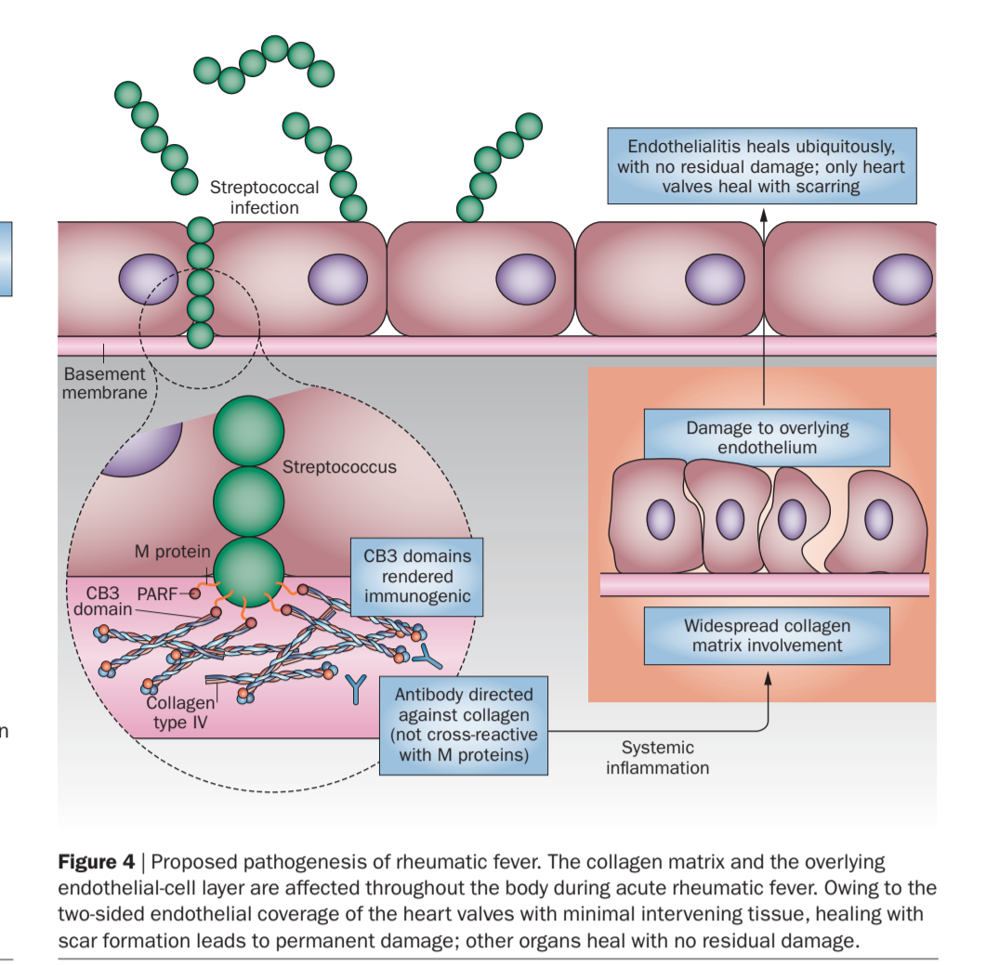

Slide 27
Immunopathogenesis of Rheumatic Valvulitis
Auto-Abs home in, damage and inflame the valve endothelium (? Laminin)
Complement mediated injury takes over
Upregulation of VCAM-1 occurs on endothelial surface
T cell mediated extensive injury and tissue infiltration via VCAM-1
CD4+ TH1 mediated granulomatous inflammation
IFN gamma and TNF alpha mediated fibrosis, Low IL4 production
Neovascularization, persistence of inflammation & scarring

Slide 28
IMMUNOPATHOGENESIS – A TWO HIT HYPOTHESIS
1. Auto-Abs home in, damage and inflame the valve endothelium (? Laminin)
Complement mediated injury takes over
Upregulation of VCAM-1 occurs on endothelial surface
2. T cell mediated extensive injury and tissue infiltration via VCAM-1
(Epitope spreading – vimentin, myosin, ? Ags on VICs)
CD4+ TH1 mediated granulomatous inflammation
IFN gamma and TNF alpha mediated fibrosis, Low IL4 production
Neovascularization, persistence of inflammation & scarring

Slide 29
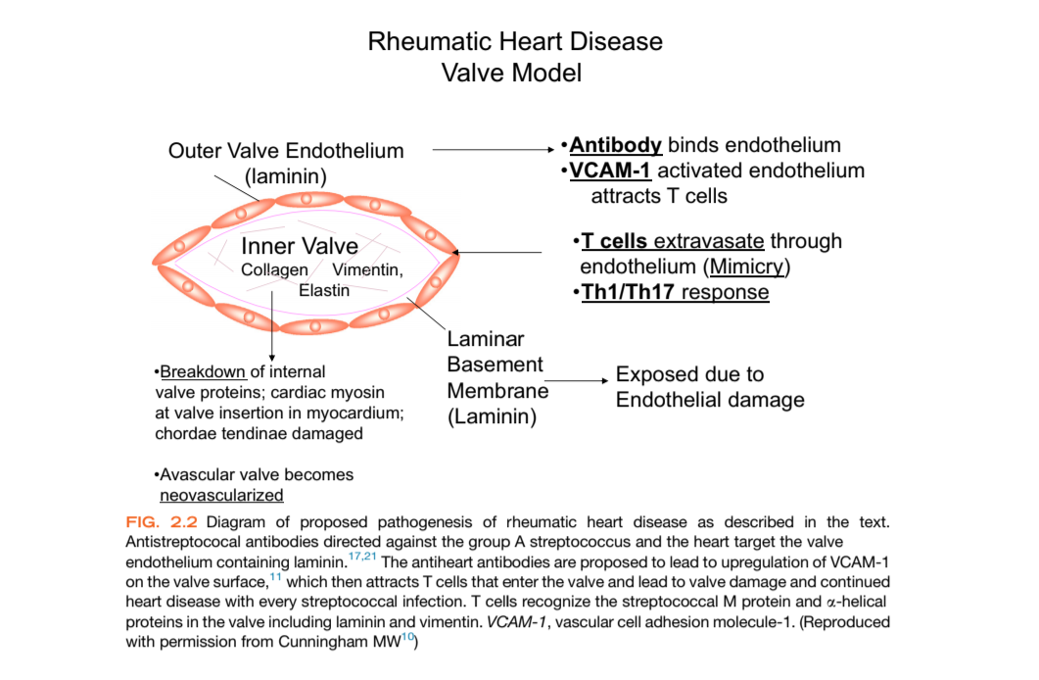
Rheumatic Valvulitis

Slide 30
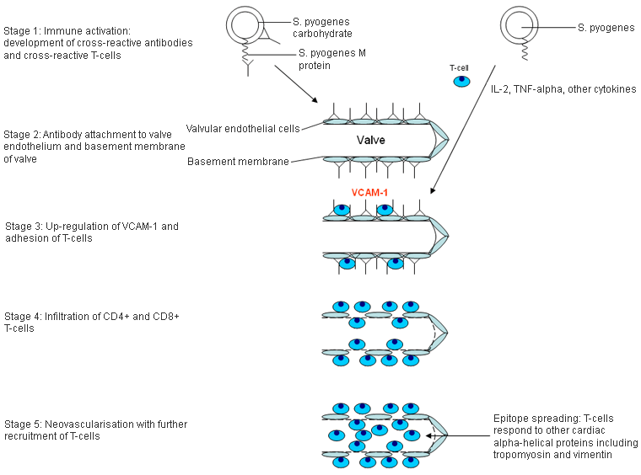

Slide 31
CLINICAL FEATURES
LICKS THE JOINTS, BITES THE HEART

Slide 32
Typical attack of rheumatic fever follows an episode of streptococcal pharyngitis after a latent period of 2 to 3 week
One third of patients who develop rheumatic fever do so after asymptomatic GAS, and in outbreaks, up 58% of patients have no symptoms of pharyngitis
Age group – 5-15 years

Slide 33
Arthritis
Joint involvement is more common (almost 100%), and more severe in young adults than in teenagers (82%) and children (66%).
typically described as “migratory,”
affected joint may be inflamed for only a few days to 1 week
At the onset of the illness the joint involvement is asymmetric and usually affects the lower limbs.
Monoarthritis has been reported in 17% to 25%
large joints such as the knees, ankles, elbows & wrists most frequently involved.
If joint swelling persists after 4 weeks- consider other conditions, such as juvenile idiopathic arthritis or SLE.

Slide 34
Jaccoud arthritis or arthropathy (or chronic post–rheumatic fever arthropathy)
occur after repeated attacks of rheumatic fever and results from recurrent inflammation of the fibrous articular capsule.
There is ulnar deviation of the fingers, especially the fourth and fifth fingers,
usually painless, and there are no signs of inflammation.

Slide 35
CARDITIS
Carditis is the most serious manifestation of rheumatic fever because it may lead to chronic RHD
Incidence of carditis in rheumatic fever varies with the age-
90% to 92% of children under age 3 years, 50% of children age 3 to 6 years, in 32% of teenagers age 14 to 17 years, and only in 15% of adults with a first attack

Slide 36
Myocarditis
in the absence of valvulitis is unlikely to be rheumatic in origin.
It should be accompanied by an apical systolic or basal diastolic murmur.
Patients with myocarditis may develop cardiomegaly and CHF.
Myocardial damage may manifest with electrocardiographic changes, which include varying degrees of heart block.
It occurs in 5% to 10% of the initial episodes and is more frequent during recurrences of rheumatic fever.

Slide 37
PERICARDITIS
Pericarditis can be detected clinically in about 10% of patients.
associated with anterior chest pain and a pericardial friction rub may be detected on examination.
The pericardial effusion may sometimes be large, but cardiac tamponade is rare, and constrictive pericarditis does not occur.

Slide 38
ENDOCARDITIS
The most common valvular lesion is mitral regurgitation causing an apical pansystolic murmur. Aortic regurgitation is less common.
Stenotic lesions are uncommon in the early stages of the disease
Transient apical mid-diastolic murmur (Carey-Coombs) may occur .
In patients with a history of previous RHD, a change in the character of the murmurs or the appearance of a new murmur will indicate the presence of acute rheumatic

Slide 40
MITRAL VALVE INVOLVEMENT
Most common valvular involvement
Pathogenesis of MR
Valvulitis
Mitral annular dilatation (96%)
Leaflet prolapse –more common anterior(94%)
chordal elongation(90%)
Chordal rupture
Valvulitis
verrucous formation
nodules along the line of closure of valves
Linear relationship between the severity of MR during the first episode of RF and subsequent RHD.

Slide 41
Sydenham chorea
More common in females
Prevalence : 5–36%
Description:
quasi purposive involuntary movement which subsides with sleep or sedation
Emotional lability, incordination, muscular weakness
fretful, irritable, inattentive to schoolwork
clumsiness and a tendency to drop objects
Change in handwriting

Slide 42
Latent period – 1- 8 months after a GAS infection
Recurrence- uncommon; sometime with pregnancy / OCP usage
Usually fully recover in 6 weeks, rarely upto 6 months
23% pure rheumatic chorea developed MS in 20 yr follow up & 27% in 30 yr period
Inflammatory markers & ASO titres may be normal ( long latent period)

Slide 43
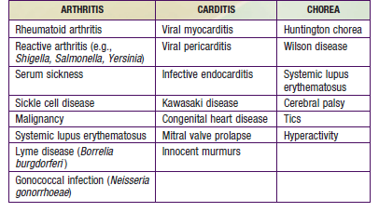
Differential diagnosis

Slide 44
SUBCUTANEOUS NODULES
usually firm, painless, and freely movable .
The nodules vary in size from 0.5 to 2 cm
tend to occur in crops .
SITE -over bony prominences and extensor tendon
scalp, especially the occiput, and the spinous processes of the vertebrae, elbows, wrists, knees, ankles and Achilles tendon
Lasts for 1-2 weeks, rarely to a month
Multiple crops of nodules may be related to the severity of the rheumatic carditis

Slide 46
Erythema Marginatum
less common manifestation of rheumatic fever and occurs on the upper arms or trunk but not the face .
rash is evanescent, pink, and nonpruritic.
Extends centrifugally and has an irregular, serpiginous border.
The rash may also become more prominent after a hot shower.
usually occurs in patients with carditis

Slide 47
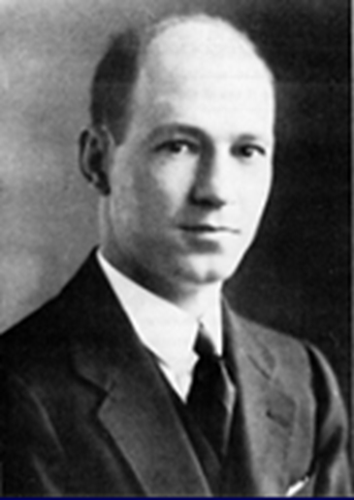
DIAGNOSIS

Slide 48
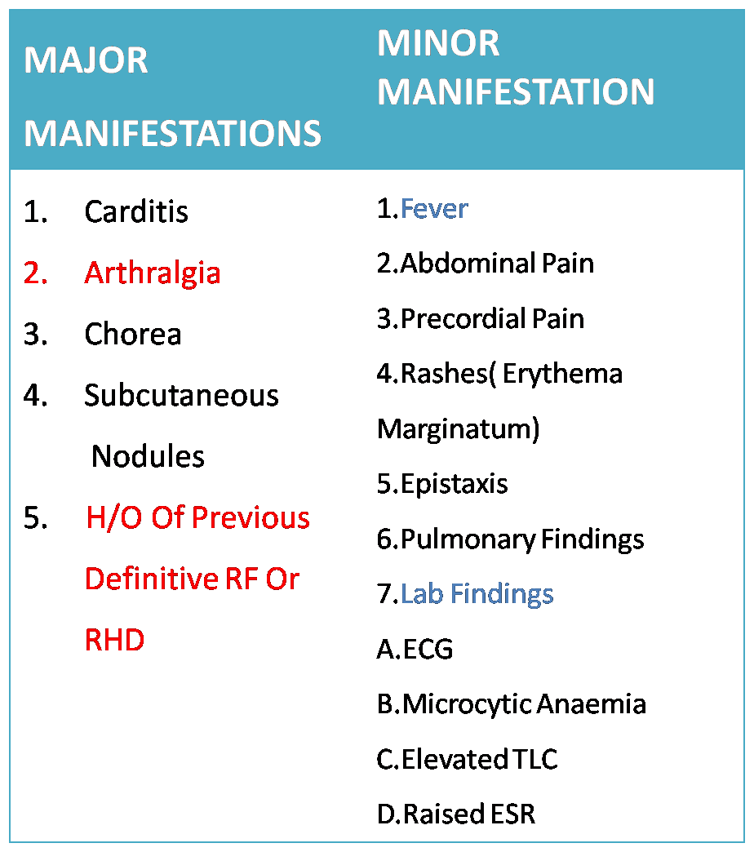
Original Duckett Jones criteria, 1944

Slide 49
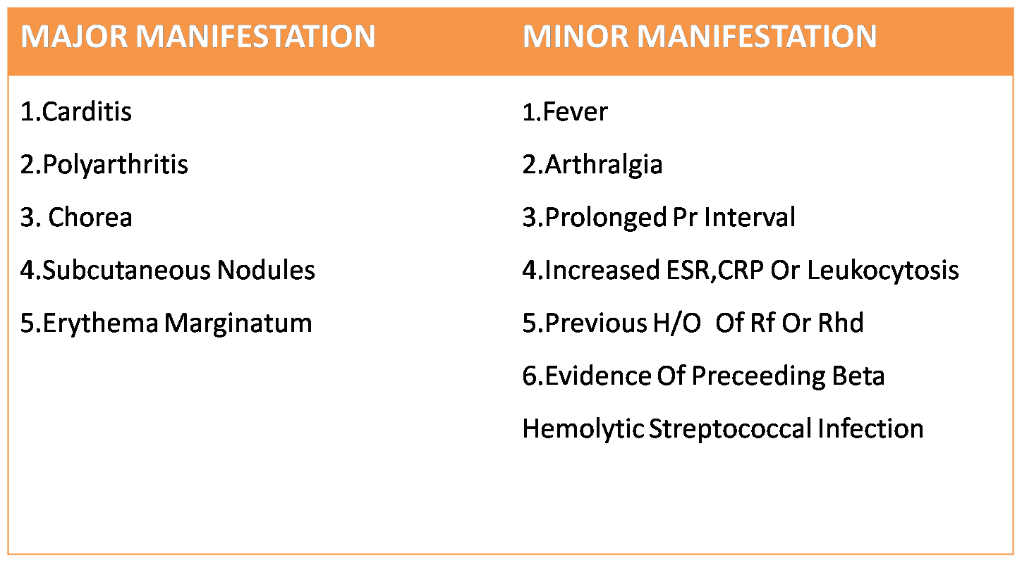
Modified Jones criteria, 1956

Slide 50
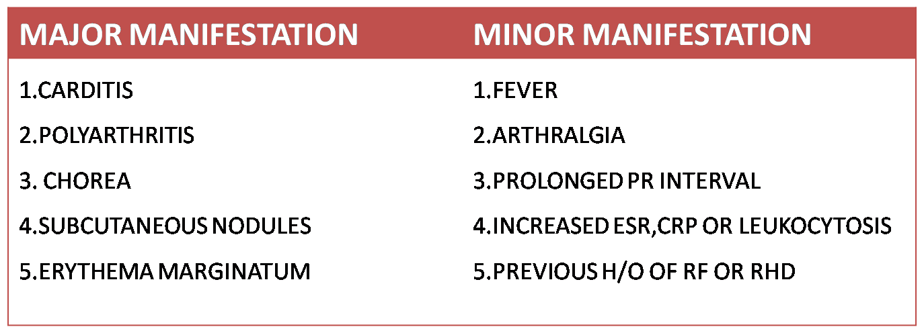
Revised Jones criteria, 1965

Slide 51
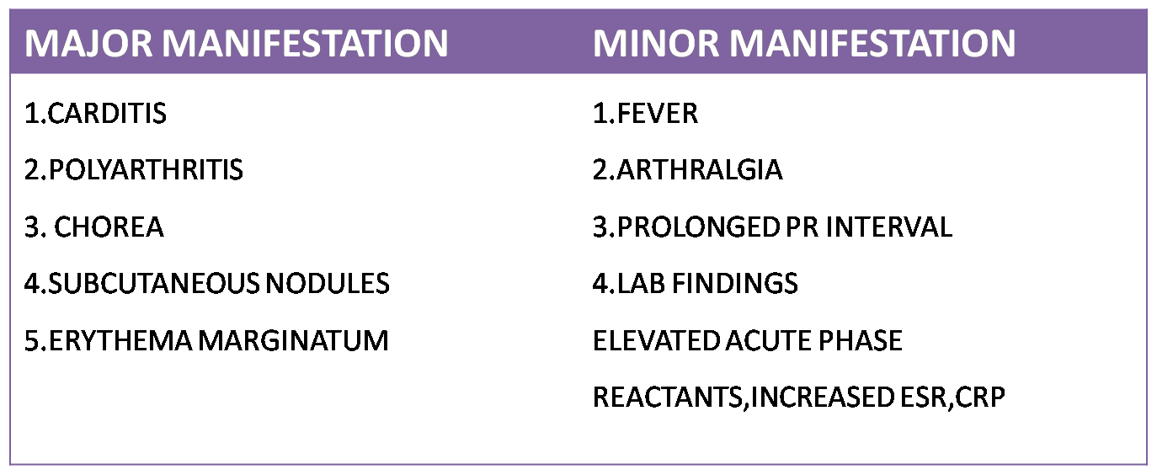
Jones criteria update, 1992

Slide 52
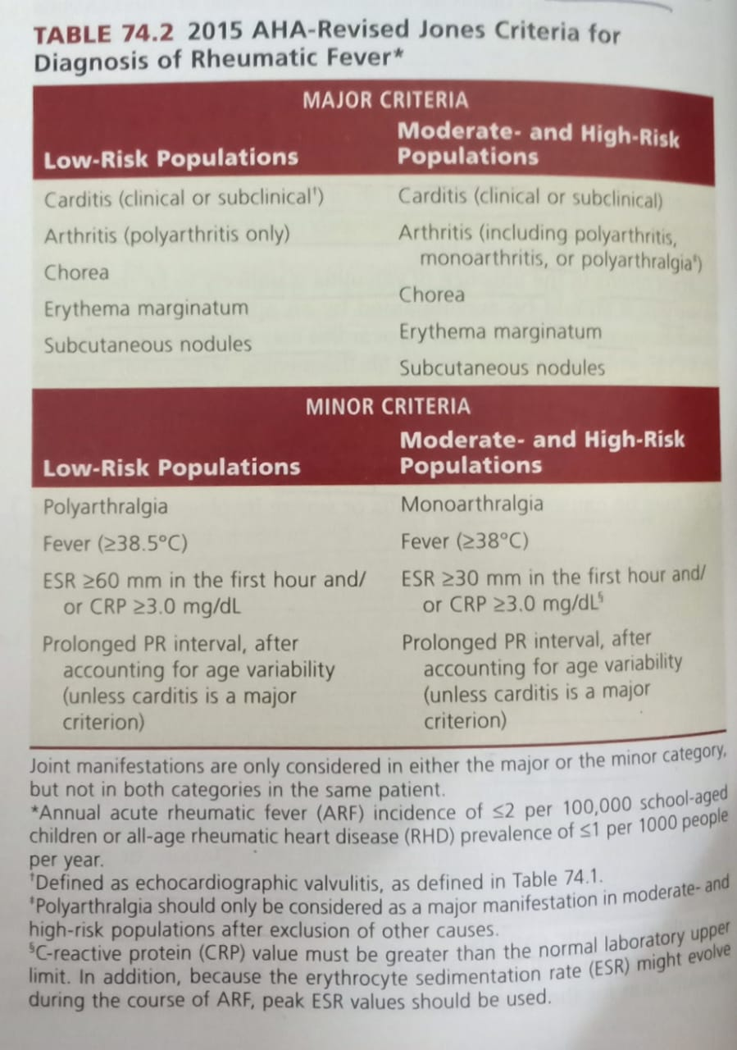

Slide 53
For all patient populations with evidence of preceding GAS infection
Diagnosis: INITIAL ARF: 2 Major manifestations Or
1 major + 2minor manifestations
Diagnosis: RECURRENT ARF: 2 Major or
1 major + 2 minor or
3 minor

Slide 54
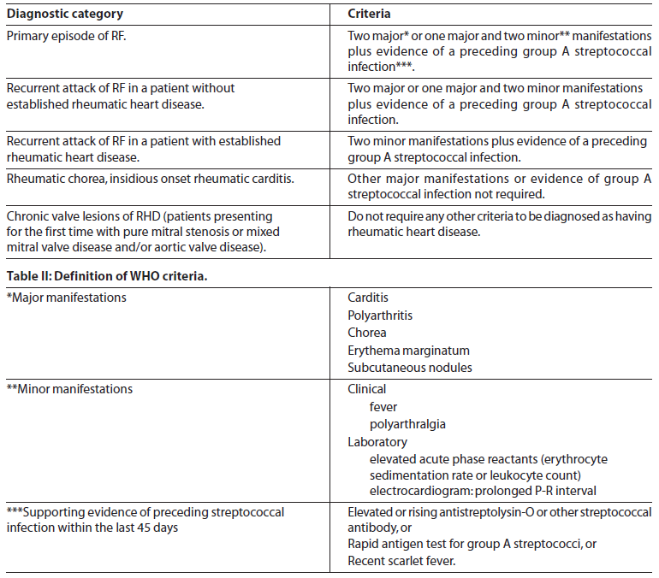
WHO 2002-2003

Slide 55
WHO 2002-2003

Slide 56
Evidence of GAS
Throat culture
The gold standard for diagnosing streptococcal pharyngitis.
Throat swabs should be inoculated on culture media within 5 hours.
Limitations:
It does not differentiate between a carrier state and active infection.
1/3 of patients with rheumatic fever give no history of a preceeding pharyngeal infection.
delay in obtaining results of throat cultures

Slide 57
ANTISTREPTOLYSIN ANTIBODY
Most widely used
Two fold rise in paired serum sample taken 2-4 weeks apart more specific than a single sample
Appears :7 to 10 days after the infection
peak detection :2 & 3 weeks after the onset of RF
maintained for 2-3 months before declining
ASO Titre
> 240 Todd units in adults
> 320 Todd units in children > 5 yrs

Slide 58
Anti DNAse B
begin to rise 1 to 2 weeks and peak 6 to 8 weeks after infection
Anti DNAse 1:60 in preschool
1:480 in school age
1:340 in adult ( NORMAL TITRE)
Single antibody test - ( only ASO) - 80-85%
Multiple antibody test- (ASO +ANTIDNase B) - 95-100%

Slide 59
ECG
Persistent sinus tachycardia & an elevated sleeping pulse rate are signs of carditis
2)Sinus bradycardia
3) PR prolongation
Seen in 20- 30% of cases
Proposed theory – due to vagal overactivity, myocardial inflmn
No correlation with carditis and future development of RHD
4) High grade AV block ,CHB
5) pericarditis
6) QT prolongation

Slide 60
Echocardiography in ARF
The significance:
Among various manifestation, carditis can cause death in acute stage or lead to long term morbidity
Echo is the only modality by which carditis can be assessed reliably
Notes:
60

Slide 61
Doppler findings in rheumatic valvulitis
MITRAL REGURGITATION
Seen in 2 views
In at least 1 view jet length >2cm
Peak velocity > 3m/sec
Pan-systolic jet in at least one envelope
AORTIC REGURGITATION
Seen in 2 views
In at least one view jet length >1cm*
Peak velocity >3m/sec
Pan-diastolic jet in at least one envelope

Slide 62
Morphological findings in echocardiogram in ARF
Acute mitral valve
Annular dilation
Chordal elongation
Chordal rupture resulting in flail leaflet with severe mitral regurgitation
Anterior (or less commonly posterior) leaflet tip prolapse
Beading/nodularity of leaflet tips
Aortic valve changes
Aortic valve changes in either acute or chronic carditis
Irregular or focal leaflet thickening
Coaptation defect
Restricted leaflet motion
Leaflet prolapse
Notes:
Chordal thickening and fusion
Restricted leaflet motion
Calcification
62

Slide 63
If the aetiology of aortic or mitral regurgitation on Doppler echocardiography is not clear, the following features support a diagnosis of rheumatic valve damage
Both mitral and aortic valves have pathological regurgitation
The mitral regurgitant jet is directed posteriorly
Multiple jets of mitral regurgitation
The presence of morphological or anatomical changes consistent with chronic RHD
Excessive leaflet motion of the tips of the AMVL or PMVL
Restrictive leaflet motion (including subchordal thickening)
Definite thickening of anterior mitral valve leaflets > 3mm
Mitral stenosis with a mean valve gradient > 4mmHg
Notes:
63

Slide 64
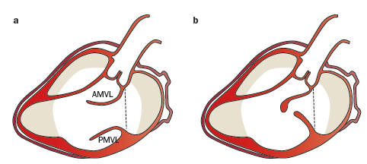
RESTRICTED MV LEAFLET MOTION
NORMAL RHD

Slide 65
EXCESSIVE LEAFLET TIP MOTION
a- normal b – RHD c - MVP

Slide 67
VIJAYA’S ECHO CRITERIA

Slide 68
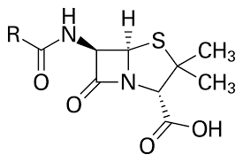
TREATMENT

Slide 69
AIM-
to suppress the inflammatory response and thus minimize the effects of inflammation on the heart and joints
to eradicate the GAS from pharynx
to provide symptomatic relief and
to commence secondary prophylaxis.

Slide 70
Treatment of rheumatic fever
General measures
pain relief
Bed rest
2 weeks for arthritis
4-6 weeks for carditis without failure
Until CCF resolves in patients with CCF

Slide 71
ANTIINFLAMMATORY THERAPY
1) Aspirin (once diagnosis is confirmed) with 100mg/kg for 2 weeks and then gradually tapered to 60 -80 mg/kg for another 4 wks
2) naproxen alternative 10-20mg/kg/day
3) steroids - Prednisone (1–2mg/kg-day, to a maximum of 80mg/day given once daily, or in divided doses) is usually the drug of choice in CHF

Slide 72
Indication for steroid
- not responding to salicylates
- worsening with CHF
After 2–3 weeks of therapy the dosage decreased
by 20–25% each week .
While reducing the steroid dosage, a period of overlap with aspirin is recommended to prevent rebound of disease activity

Slide 73
Chorea :
Reassurance & sedation
Nsaid & steroid have no role
Haloperidol 0.25-0.5 mg/kg/day
Carbamzepine(7-20 mg/kg/day) & valproate (15mg/kg/day) –refractory cases
Ivig & plasmapheresis-no benefit

Slide 74
Primordial prevention
Improvement in socio-economic status
(ii) Prevention of overcrowding
(iii) Improving nutritional status
(iv) Availability of prompt medical care
(v) Public education regarding
PRIMARY PREVENTION-
TREATMENT OF STREP PHARYNGITIS

Slide 75
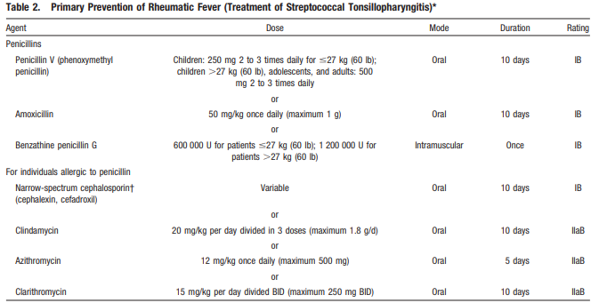

Slide 76
Secondary prophylaxis
ANTIBIOTIC | MODE | DOSE
Benzathine benzyl penicillin | Single im every 3-4 weeks | >30kg – 12 lakh U <30 kg- 6 lakh U
Penicillin V | Oral | 250 mg bd
Sulfonamide ( sulfadiazine, sulfadoxine, sulfisoxazole) | oral | Adult >30kg- 1g od <30 kg – 500mg od
Erythromycin ethylsuccinate | Oral | 250mg bd
Notes:
76

Slide 77
Duration of secondary prophylaxis
Category of patienT | Duration
Without proven carditis | 5 years AFTER last attack or 18 yrs of age (longer)
with cardits (mild MR, healed carditis) | 10 yrs after last attack or 25 years of age (longer)
More severe valvular disease | Life-long
After valve surgery | Life long

Slide 78
Antistreptococcal vaccine
Components of GAS used in vaccine development
1)M- protein
2)GAS C5a peptidase, a major surface virulence factor
3) Fibronectin binding protein sfb1
4) Chimeric peptide J8 from the conserved region of the M- protein
M protein vaccines-less likely to succeed
1) Heterogeneous distribution of strains- varies from place to place and keeps changing even within a closed community in a short period.
2) On the basis of emm typing of M-protein more than 250 strains of GAS can cause infection and provide only strain-specific immunity.
3) GAS has a strong tendency for mutation

Slide 79
THANK YOU

